Slide 1
What is Power Pivot?
Allows us to create very powerful pivot tables
Connect to data in the Data Model (via Power Query)
Create relationships between tables (alt. to VLOOKUP)
Create Measures using DAX formula language
Create reports with pivot tables, pivot charts, and CUBE function formulas.
ExcelCampus.com

Slide 2
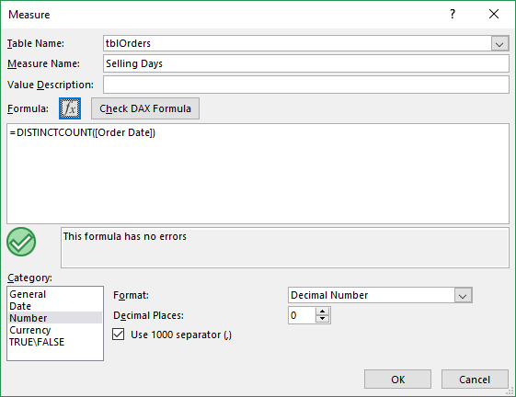
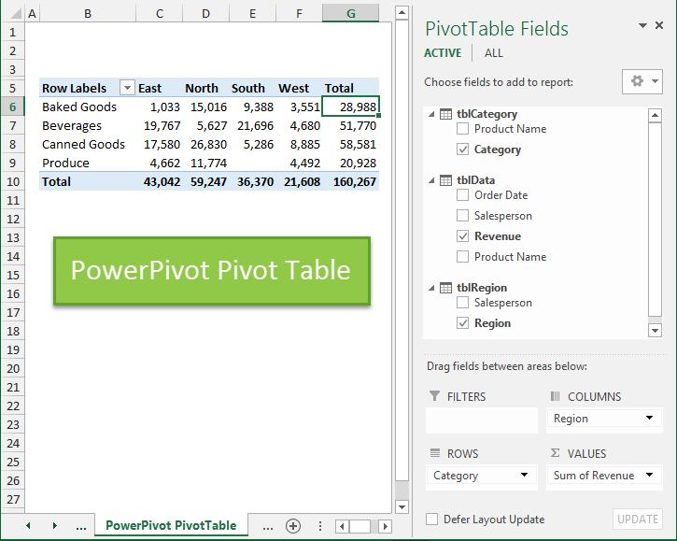
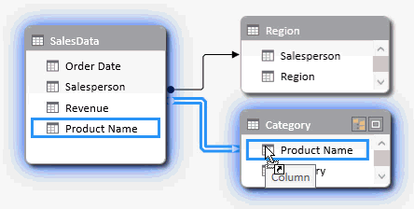
Power Pivot Process
Connect to Data Model & Create Relationships Between Tables
Create Measures with DAX for Advanced Calculations
Create Reports with Pivot Tables, Charts, & CUBE fx
ExcelCampus.com

Slide 3
What is the Data Model?
Term that is used interchangeably with Power Pivot.
Place where the data (tables), relationships, and measured are stored within the Excel file.
Power Query can add tables to the Data Model.
Pivot tables that use the data model will have multiple tables in the Pivot Table Fields List.
ExcelCampus.com

